Slide 1
E-commerce Sales Performance Review: Insights & Strategic Focus
SULFANA K A 26-092025

Slide 2
Key Highlights
Strong Revenue Growth: Total revenue/sales reached $5.87 Million, indicating solid market performance.
Profitability Challenge: The overall profit margin is 16.54%,Analysis is required to address negative profit margins in certain product areas.
Top Performer: Electronics is the leading category by sales and profit.
Focus Area: The South region and Home/Electronics categories are major revenue drivers.

Slide 3
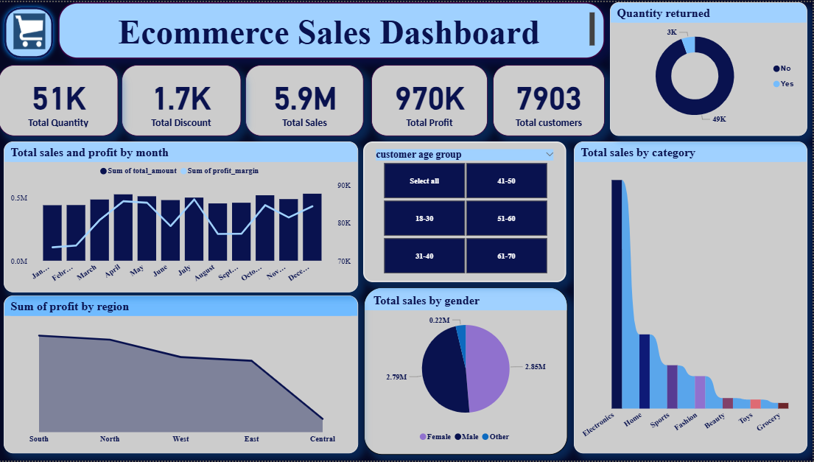
Snapshot of E-commerce Performance

Slide 4
Regional & Demographic Performance
Regional Dominance: The south region accounts for the largest share of sales (as seen in the screenshot's 'Sales by Region' visual). The central region has the lowest sales.
Top Customers (Age):young adults(18-30) are the largest customer segment , contributing substantially to sales and growth.
Top Customers (Gender):The Female segment drives a slightly higher contribution for order , profit and overall sales.
Sales trends : Over the period, sales growth increased in December, it helps to analyze the peak sales during holidays.

Slide 5
Product Category and Margin Analysis
Best Sellers: Electronics , Home categories are leading the highest revenue
Actionable Insight: Grocery categories contribute most to negative profit (-9K).So it is essential to revisit the strategy and make necessary changes to improve profitability (e.g., negotiate better shipping costs, adjust pricing, or reduce discounts).
Product analysis :Very low returned rate for orders , indicating the product quality and customer satisfaction.

Slide 6
Recommendations & Future Focus
Actionable Recommendations
Optimize Shipping/Discounts: Implement a targeted review of shipping costs and discounts for products with negative profit margins (especially in the [grocery]).
Boost Central Region: Develop a targeted marketing campaign or special offers for the Central region to bring its performance closer to the West and South.
Harness Top Performers: Continue to promote and ensure stock availability for the Home and Electronics categories, as they are the primary drivers of revenue.

